Slide 1
Interview Skills
By Group 4
Date here

Slide 2
Preparation for an interview
Research | Dressing | Other preparations

Slide 3
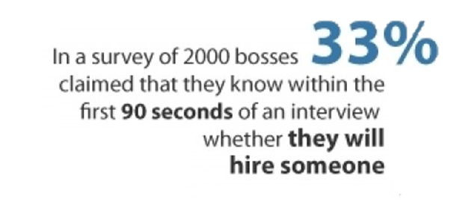
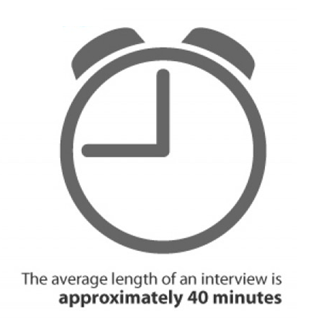
Did you know?

Slide 4
Preparing for success
“Before anything else, preparation is the key to success” – Alexander Graham Bell
“By failing to prepare, you are preparing to fail – Benjamin Franklin

Slide 5
Know thyself
Prepare for Commonly asked questions
Tell me about yourself/Strengths/Weaknesses
Prepare but avoid memorizing a script
Know your CV/resume
Potential questions ? ( past projects )
Bring in portfolio or past project to show

Slide 6
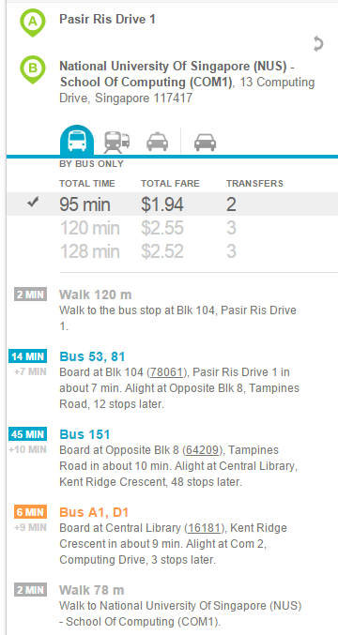
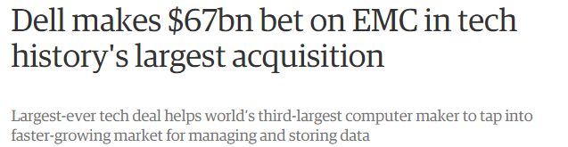
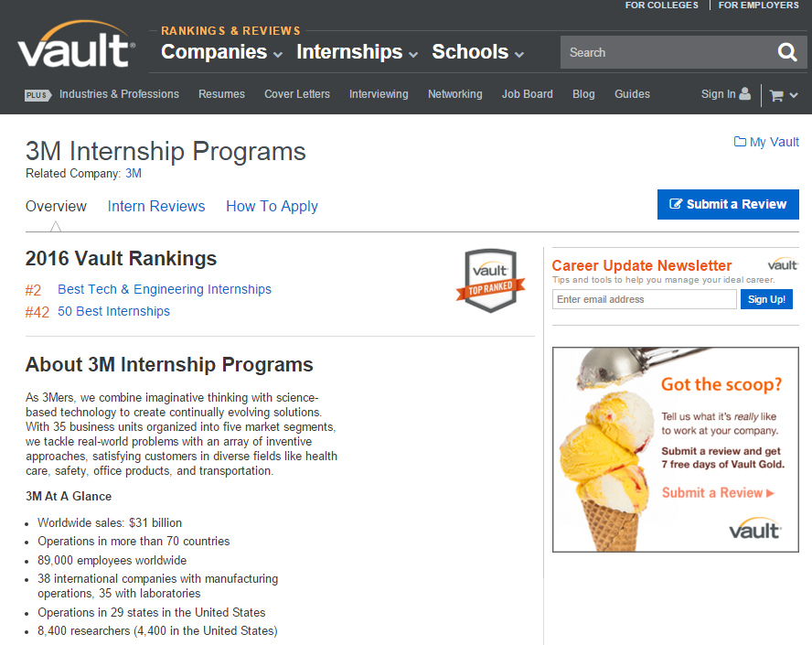
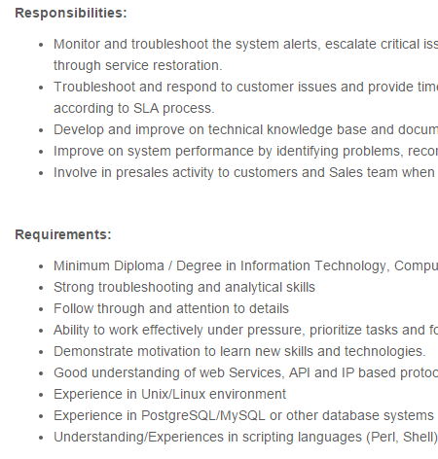
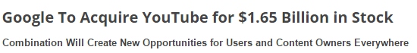
Know thy “enemy”
Company’s profile & background
Tools : Vault, CareerSearch and Wetfeet
News about Company & Competitors
Job requirements and key responsibilities
Route and time taken to travel (gothere.sg)

Slide 7
First Impression counts
Dress accordingly
Smart casual ? Formal ? Clarify when in doubt
Groom yourself
Haircut, nails, facial hair
Smell good
Deodorant instead of overpowering perfumes/cologne
Don’t smoke or eat right before interview
Feel good
Sufficient sleep the night before
Hydrate yourself

Slide 8
General skills: “Do”s
Body management | give relevant answer

Slide 9
Manage your mind
convey
Body
Mind
control
Fidgety movements
Defensive position
Avoid of eye contact
Lack of energy
Nervousness
Lack of confidence
Untruthfulness
Boredom
Notes:
Body language conveys more information about your mind state than the spoken language, so we need to manage our body language in interviews. Our body and mind are close related. People infer our mind-state from our body movement, because our body movement is determined by our mind-state.
Manage of body movement is essentially the management of our mind state.
Mind comes first.
Confident people naturally look convincing and passionate people naturally uses body movement to convey ideas.
If the mind is nervous, you cannot stop being look nervous. You may try to stop scratching the hair, but you may not notice your voice is shaking. There are endless list of things to be fixed if the mind is not prepared.

Slide 10
Give relevant answers
Know what are the interviewers looking for.
Fit your ability into their requirement.
Notes:
You and your interviewer meet for a purpose. With the limited time, you need to give your interviewers as much evidences as you can to convince him/her that you fit the requirement for the opportunity.
This is so important as I want to share about my personal experience here.
I have failed the USP interview…. Because…

Slide 11
Give relevant answers
Sales Executive / Manager*
We are a performance driven organization that believes the sky is the limit, with a driven and determined sales force. Similarly, we are looking for Sales Executives/Manager that have the ability to support our sales team effectively, with an attractive commission scheme that rewards performers that contribute to both the sales and team growth.
Performance driven
Support sales team
Attractive commission scheme
*Source : http://www.stjobs.sg/sales-executive-manager-job/view-job/1412928
Notes:
This is an job description taken from the Stjobs website. The left-side is the text description which is not supposed to be read. On the right I have extracted 3 points from the job description.
So how should you fit yourself in the job description?
Performance driven: it stresses on the meritocracy nature of the company. Monetary result is the most essential quality for them. Do not discuss your vision and values, but share with them your working experience. You may want to talk about how did you achieve above-average result in your field. E.g. in preparing of the final exam, knowing that I am unable to get all the As, I do detailed revision for the courses I am good at to ensure an A and trying all the past-year papers for the modules which I am not good at to quickly improve my grade, finally I secured my second-class honor.
Support: being responsive and know how to resolve team collaboration problems
Attractive scheme: tricky part, it is not difficult to design an attractive commission scheme. Giving more money is apparently more attractive. Unfortunately, this requirement is asking you to exploit your co-workers to the largest extent with as little rewards as possible. How to respond to such a requirement? This is an art, not a science, so you need to show them you are a successful, exploitive person. E.g. I am very strict at my co-workers, because I can give them an offer that they cannot resist. For example, ….

Slide 12
Know better from questions
How the company wish you to treat others is how the company will treat you.
Decide if the opportunity is really what you want.

Slide 13
General skills: “Don’t”s
Communications | Personal grooming | Behaviour

Slide 14

Communications
Vague Questions
Photo by: Brian Moore, https://flic.kr/p/weYd8
*Source : http://cals.arizona.edu/clubs/manrrs/MANRRS%20Web/GENERAL%20INTERVIEW%20TIPS.pdf
Notes:
Don't answer vague questions. Rather than answering questions you think you hear, get the employer to be more specific and then respond.
Answering vague questions only create opportunities for you to potentially blurt out something totally irrelevant.
In the best scenario, you answer the question accurately, in the worst, you create a bad impression for yourself.

Slide 15

Communications
Interruptions
Photo by: Kurt Bauschardt, https://flic.kr/p/kcc2QD
*Source : http://cals.arizona.edu/clubs/manrrs/MANRRS%20Web/GENERAL%20INTERVIEW%20TIPS.pdf
Notes:
Never interrupt the employer. If you don't have time to listen, neither does the employer have time to listen to you.
Additionally, this can only spell out a bad working attitude from you in the future if the employer chooses to hire you.
This will lead him or her to reconsider whether to give you the job.

Slide 16

Communications
Previous or present work partners
Photo by: Craig Sunter, https://flic.kr/p/zTu1PY
*Source : http://au.hudson.com/job-seekers/helpful-tips-career-advice/interview-preparation/interview-tips
Notes:
Do not make derogatory comments about your present or former employers, colleagues or companies.
This does not bring reflect good on you as it only portrays you as someone who is not a team player or a good subordinate.
Deriding your past or present work partners can make you look like a bitter person who might potentially cause unhappiness in the workplace if you join the employer’s company. This is clearly undesirable.

Slide 17

Behaviour
Chewing gum/Eating Food
Photo by: Veronica Aguilar, https://flic.kr/p/oDU2kk
*Source : http://cals.arizona.edu/clubs/manrrs/MANRRS%20Web/GENERAL%20INTERVIEW%20TIPS.pdf
Notes:
Eating food in almost any interview is a big no-no.
It conveys to the employers a sloppy attitude and lack of seriousness pertaining to the interview.
Additionally it can be off-putting if you are talking and there is food in your mouth.

Slide 18

Personal grooming
Heavy perfume/cologne
Photo by: edmondwong8, https://flic.kr/p/73PURc
*Source : http://cals.arizona.edu/clubs/manrrs/MANRRS%20Web/GENERAL%20INTERVIEW%20TIPS.pdf
Notes:
Smell is a very subjective thing, and the scent that you like might not be one that your potential employer likes.
On top of that, wearing strong perfume or cologne distracts the employer from the interview at hand and does not help you when you are trying to promote your expertise.

Slide 19
Common Questions

Slide 20
Tell me about yourself.
Skills not highlighted on resume
Personality
Hobbies
Keep it under 2 min

Slide 21
What is your weaknesses?
Do not present a strength
Non-critical to your job
Measures taken to alleviate it

Slide 22
Why did you leave your last job?
“You can tell more about a person by what he says about others than you can by what others say about him.”
– Leo Aikman

Slide 23
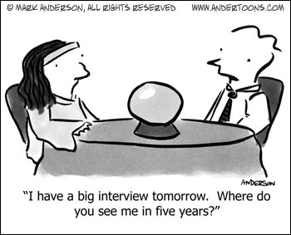
Where do you see yourself in five years?
Photo by: andertoons.com
*Source : http://www.andertoons.com/fortune/cartoon/5517/i-have-big-interview-tomorrow-where-do-you-see-me-in-five-years

Slide 24
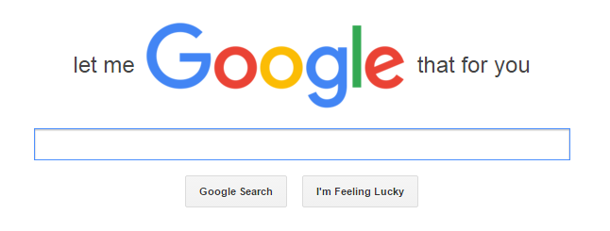
Do you have any questions for me?
*Source : http://lmgtfy.com/

Slide 25
Summing it up…
Tell stories
No contradiction
Focus on them, not yourself
Be prepared for surprises
Do not pretend to be someone you are not

Slide 26
Follow-up

Slide 27
References
https://www.unigo.com/pay-for-college/scholarships/how-to-answer-common-scholarship-interview-questions
http://www.best-job-interview.com/internship-interview.html
http://www.job-hunt.org/recruiters/smart-job-interview-answers.shtml
http://work.chron.com/clever-ways-answer-questions-job-interview-26744.html
https://collegegrad.com/jobsearch/mastering-the-interview/ten-tough-interview-questions-and-ten-great-answers
https://www.themuse.com/advice/how-to-answer-the-31-most-common-interview-questions

